Slide 1
Final Project Presentation of
Humble abode
- have a comfortable Home
CSE516 – Software Engineering and Design Pattern Lab
Group # 8
ID :
177701021–- Nishat Soultana Chy
17701067 - –Saima Akter Afrin
17701083 - – Fairooz Azim
17701088– - Sadia Sharmin
17701103 - –Maharun Nessa Meem
  Course Instructor :
  A. H. M. Sajedul Haque
  Assistant Professor
  Department of CSE
  University of Chittagong

Slide 2


Slide 3
Introduction:
The system, “humble abode” is a solution:
-To find a suitable house to buy, rent or live temporarily.
-It helps the house owners to advertise their house for sell.
- To find skilled moving service.
- To find cleaning service easily.
-To find available interior designers.
-To find furniture and accessories shops.

Slide 4
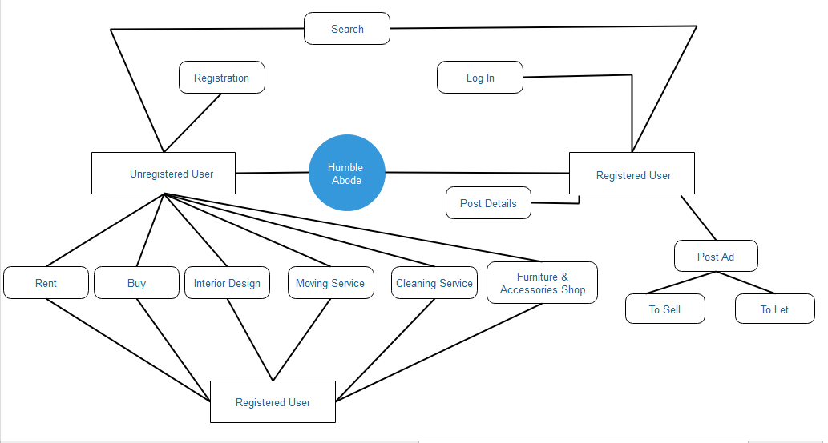
System Architecture:

Slide 5
Use Case of the System
Registration
Log In
Posting Ad
Edit Ad
Delete Ad
Searching Ad by Category for Buying home
Searching Ad by Category for rent
Searching proper home by location.
View details of a post.
Finding Interior Designer.
Finding a moving service provider
Finding a cleaning service provider
Finding online shops of furniture and accessories

Slide 6
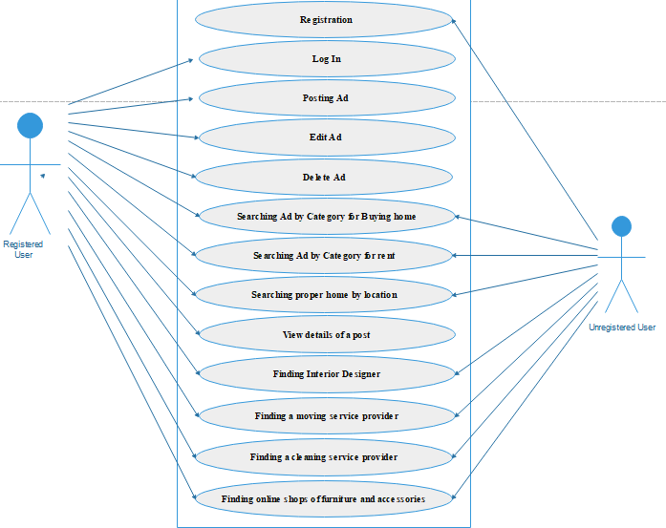
Use Case Diagram:

Slide 7
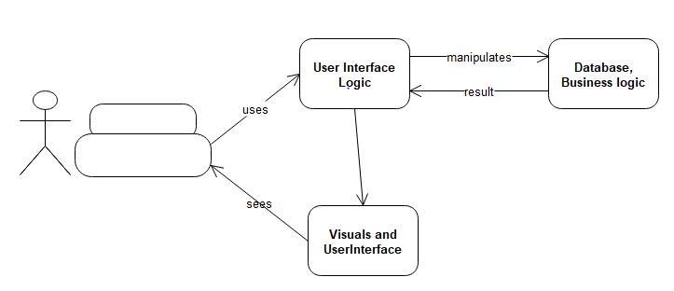
Architectural Pattern:

Slide 8
Important advantages of MVC model and causes behind choosing it:
- Faster development process.
- Ability to provide multiple view.
- Modification does not affect the entire model.
- Friendly development platform and supportive for inexperienced developers.
- MVC pattern fits for application requiring strict maintainability and test ability standards.

Slide 9
Used Design Pattern
1.Sigeleton
2.Adapter

Slide 10
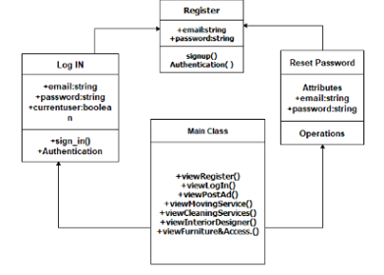
Detailed Class Diagram

Slide 11
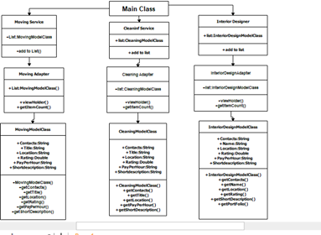
Detailed Class Diagram

Slide 12
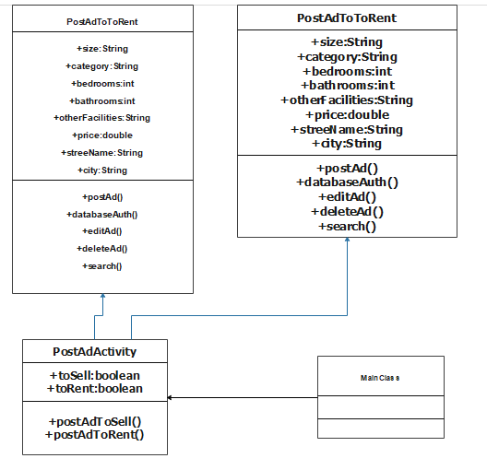
Detailed Class Diagram

Slide 13
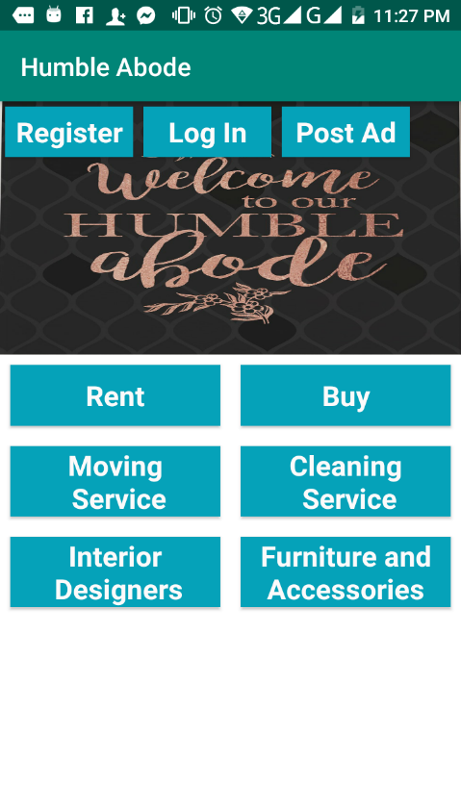
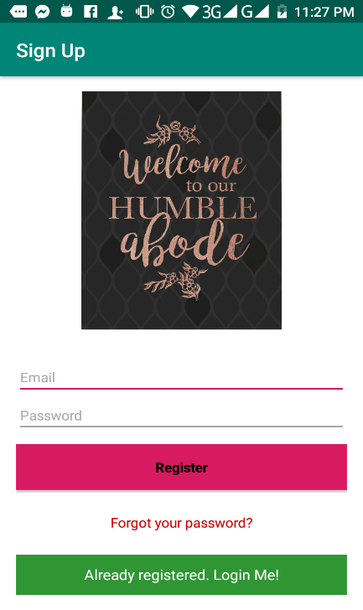
Snapshots of Our System:
A. Snap of Opening Page:
B. Snap of Registration:(UC-1)

Slide 14
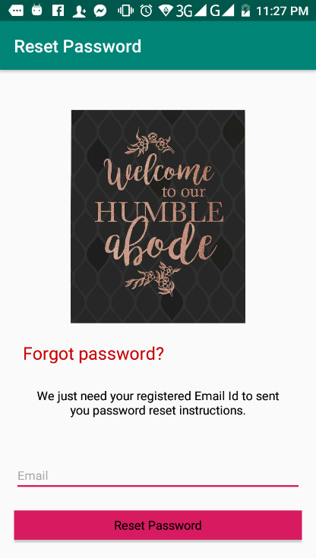
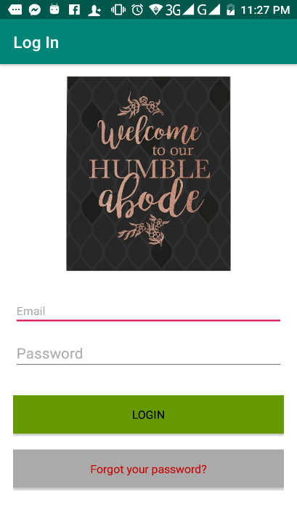
C. Snap of the Log-In Page(UC-2):
D. Snap of the Reset Password page:

Slide 15
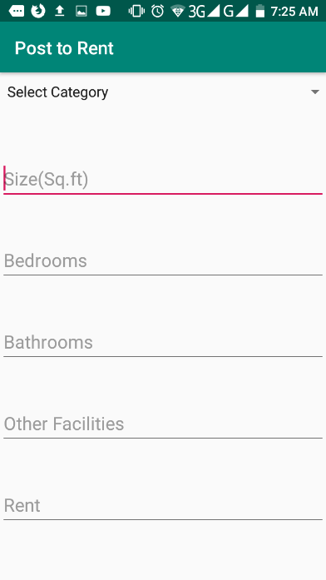
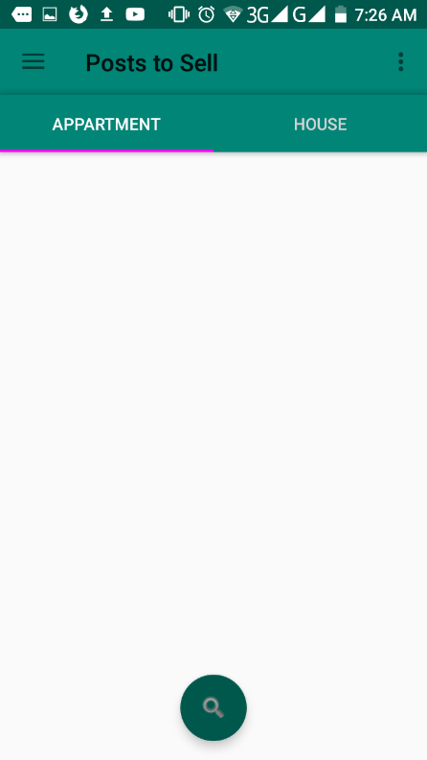
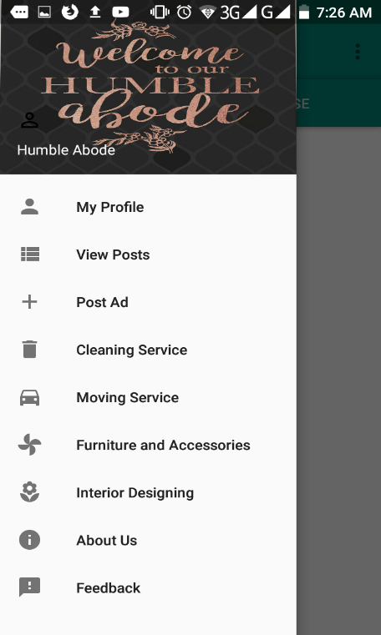
E. Snap of the Post Ad page(UC-3):
F. Snap of Searching Ad for Buying Home(UC-6):

Slide 16
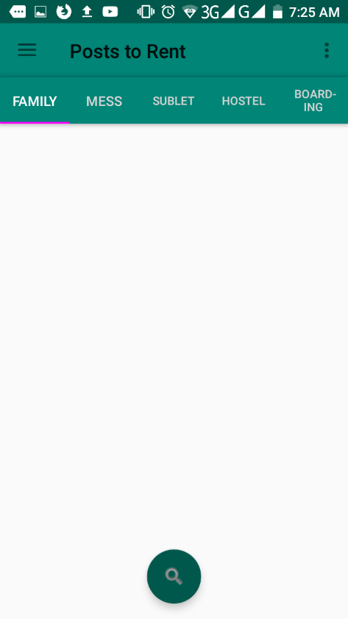
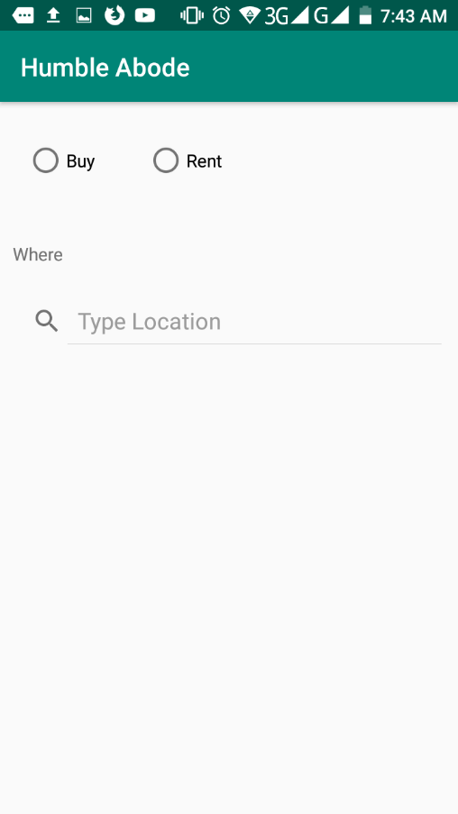
G. Snap of Searching Ad for Renting Home(UC-7):
H. Snap of Searching Ad by Location(UC-8):

Slide 17
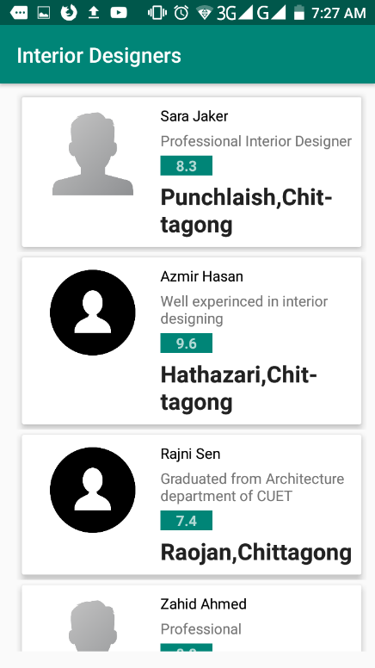
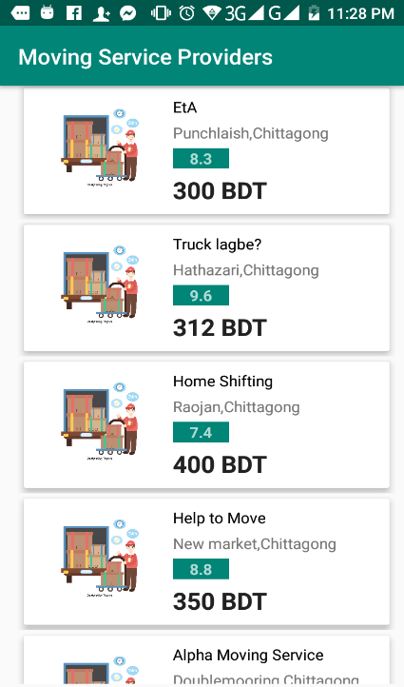
Snap of Finding Interior Designers(UC-10):
J. Snap of Finding Moving Service(UC-11):

Slide 18
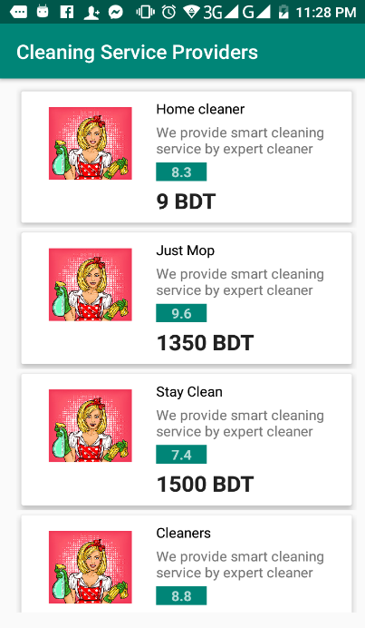
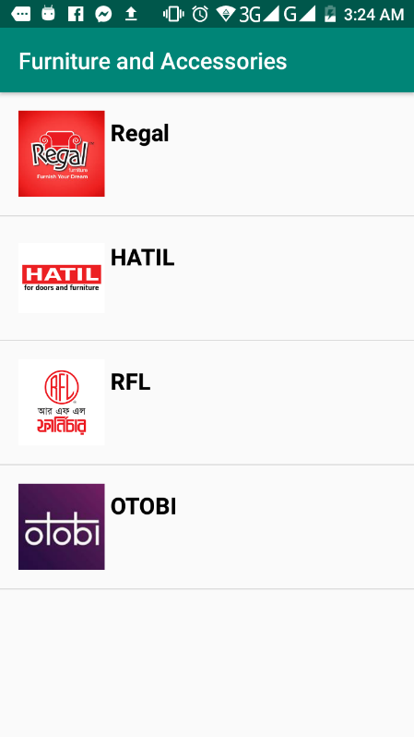
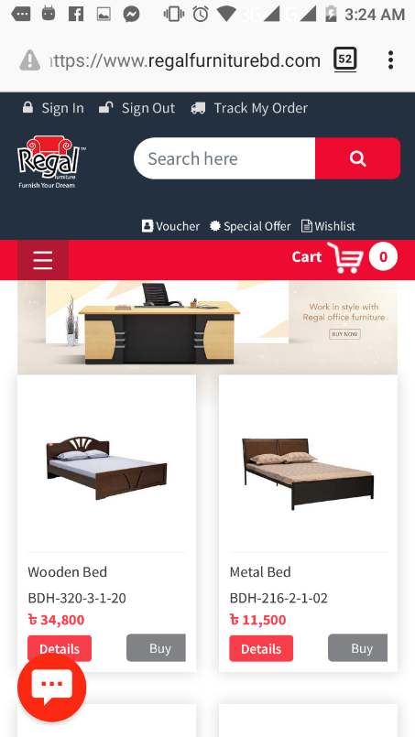
K. Snap of Finding Cleaning
Service(UC-12):
K. Snap of Finding Furniture & Accessories
Shop(UC-12):

Slide 19
Limitation of Our System:
Poor database system
Location can not be traced
Some essential services are missing

Slide 20
Future Work:
We will use Google Map to get exact location.
Chat option for the service providers and customers.
Providing electricians.
Supplying security man .
Supplying house maid.
Spreading the service worldwide.

Slide 21
Target Market :
Primarily Chittagong, Bangladesh.

Slide 22
Marketing Strategy
Researching target market
Researching competitor
Creating a landing page in social media
Making the app visible in app store( title, description, icon, screenshots)
Creating viral video content
Starting a blog
Researching audience through social media
Advertising

Slide 23
7. Conclusion:
So, here is our system and we have tried to make this system more user-friendly. We hope users will use it and get rid of the hassle of house hunting. Requirements were fulfilled while maintaining the visual and operational simplistic design. This project helped us to bond together, work together. We learnt new ways of thinking in analysing, designing and implementation process. We, the development team, thank our Project Supervisor cordially for his help and detailed evaluation and corrections in every stage of the development process. We are very lucky to have him as our Project Supervisor. This project is a success for the team and a grand experience for every individual.

